Slide 1
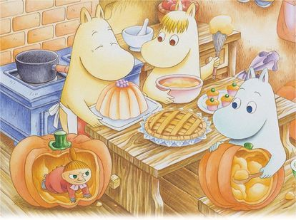

Finland
Wakaba Hayashi
Yuki Mukaiyama
Notes:
選んだ理由
Medical and educational systems are better than other countries, but finish have to pay a lot taxis, so we are interested in their life in finland.

Slide 2
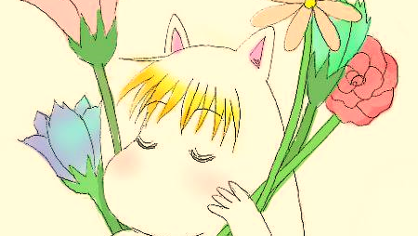
What is famous??

Slide 3
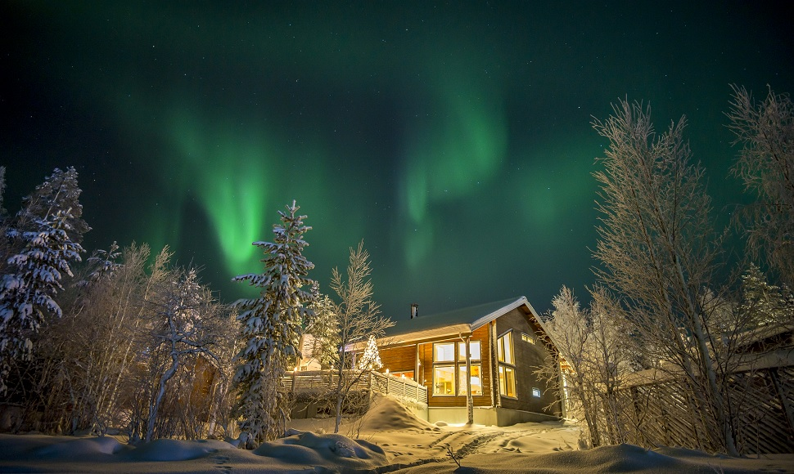
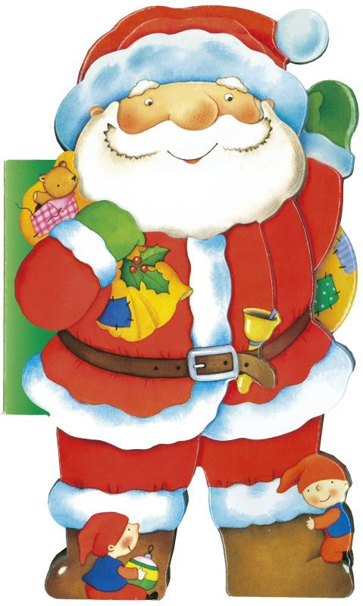
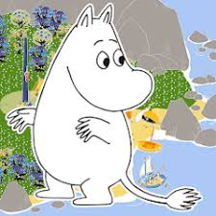
Moomin
Aurora
Santa Claus

Slide 4

What is Finland??

Slide 5
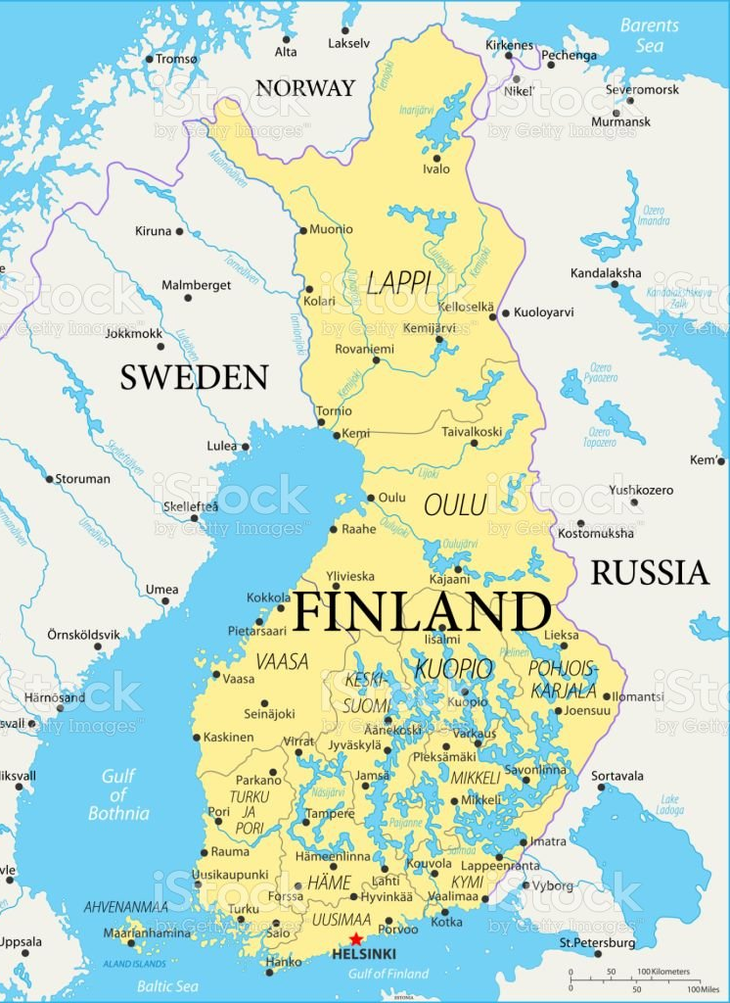

Capital : Helsinki
Population : about 5.5 million
Language : Finnish, Swedish
politics : republic
Notes:
国旗のこととかも入れたいなぁ～（意味があるなら意味調べて紹介してもおもろいかも？？）

Slide 6
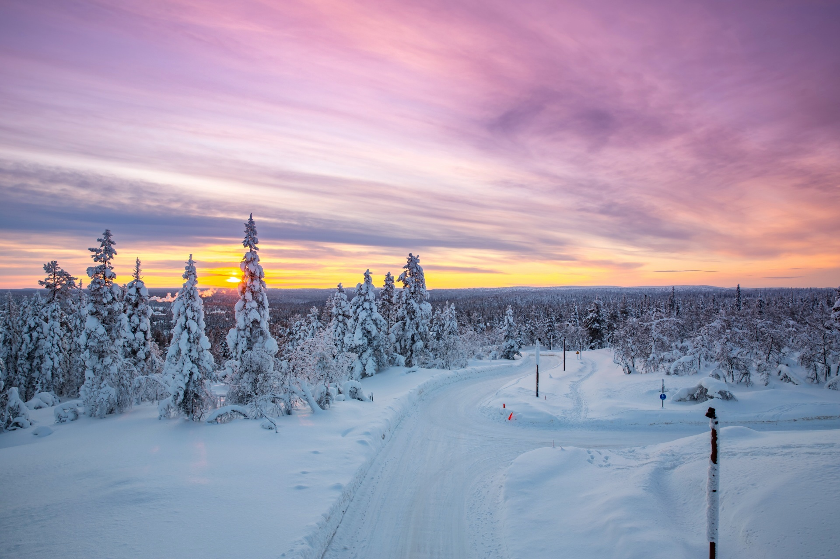
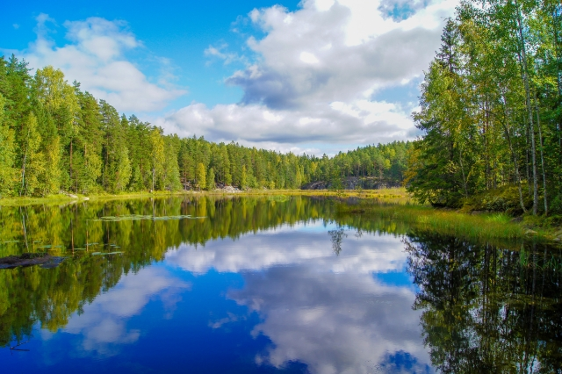


Flag
White: The country covered with snow in winter.
Blue: Many lakes and blue sky.

Slide 7
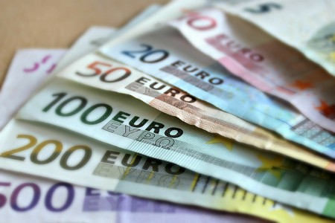
Economics : euro
Euro is used as official currency
Joined euro zone in 1999
Notes:
ここでは経済ん話とかできたらいいのかな？（使われている貨幣とかも調べると良いのかな？？）

Slide 8
Language : Finnish and Swedish
Finnish and Swedish are the official language
Notes:
ここでは経済ん話とかできたらいいのかな？（使われている貨幣とかも調べると良いのかな？？）

Slide 9
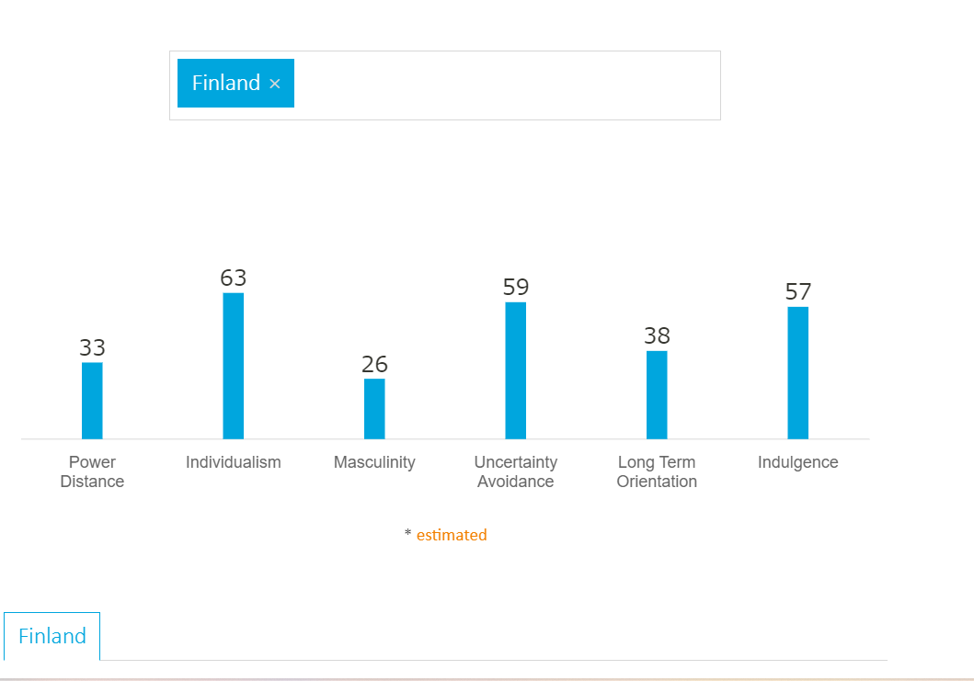
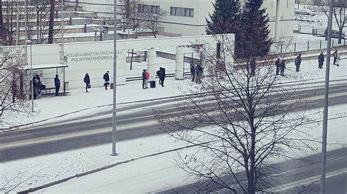
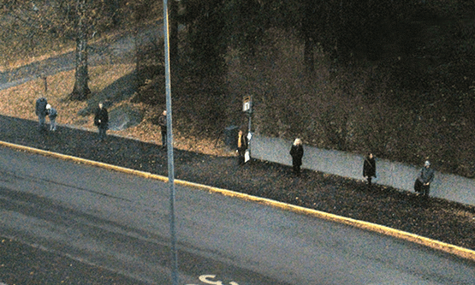
Population : about 5.5 million
Most of the population are ethnic Finns
personalities ; introverted, calm and polite
Notes:
フィンランド人の性格とかについて話して、カルチャーディメンションと絡める

Slide 10
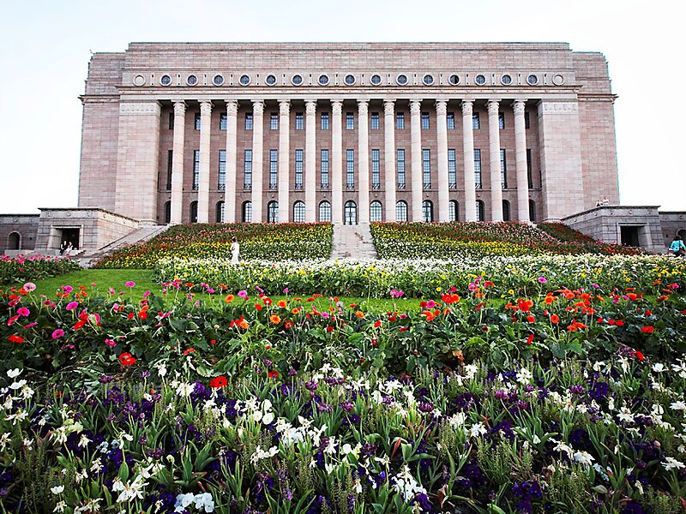
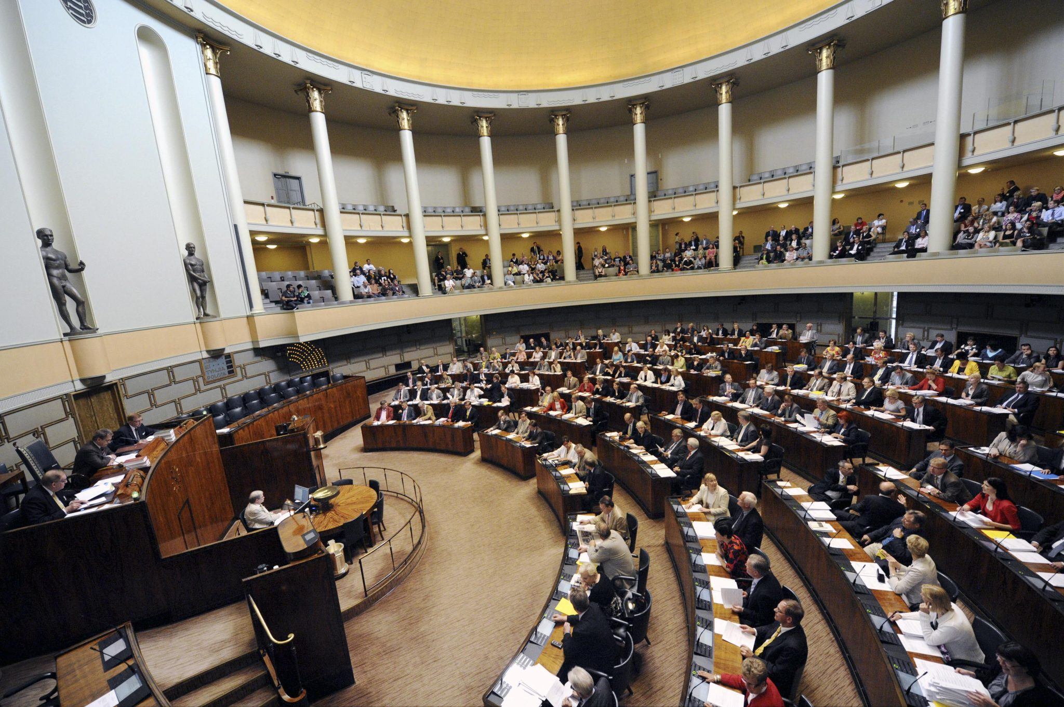
Politics : republic
Parliament in Finland
Notes:
ここでは経済ん話とかできたらいいのかな？（使われている貨幣とかも調べると良いのかな？？）

Slide 11

How to live in Finland?

Slide 12
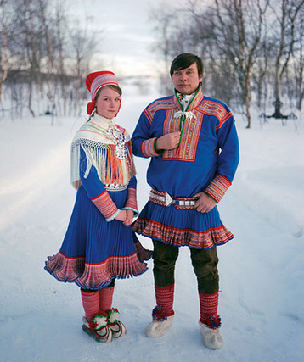
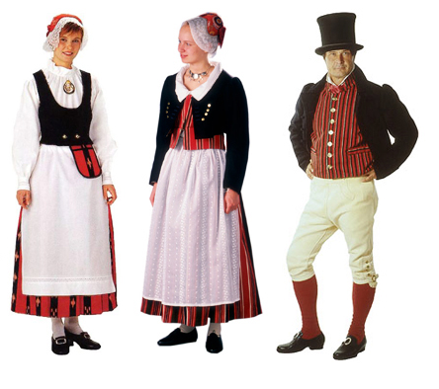
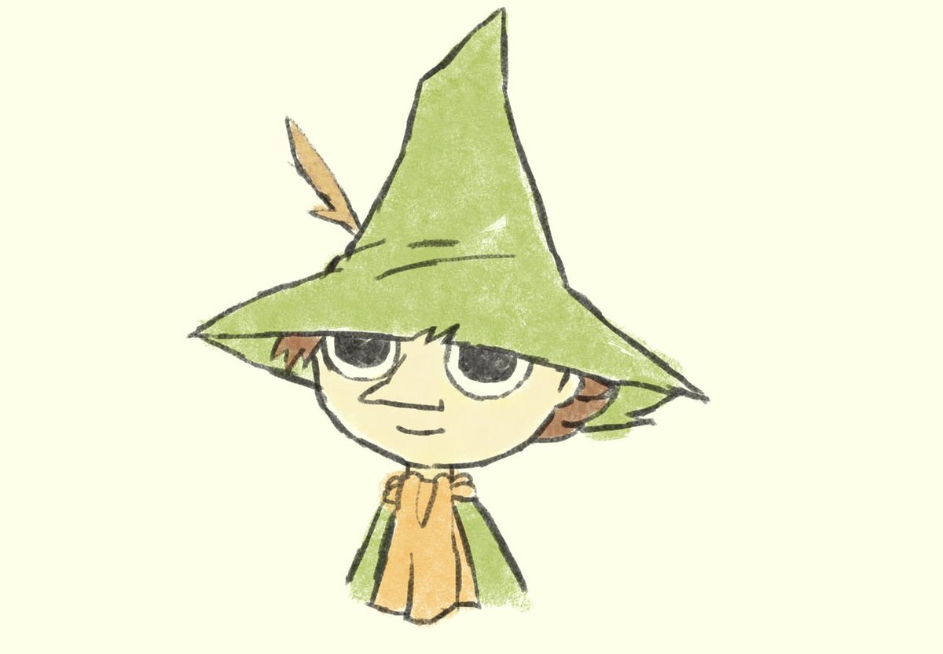
Traditional Clothes
Characteristic
Woman: white blouse, vest, wool skirt, white apron
Man: shirts, vest, jacket, pants, hat

Slide 13
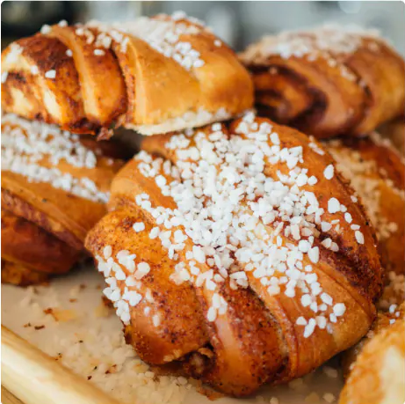
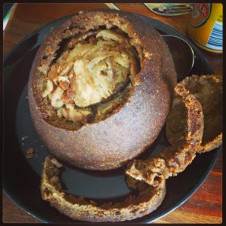
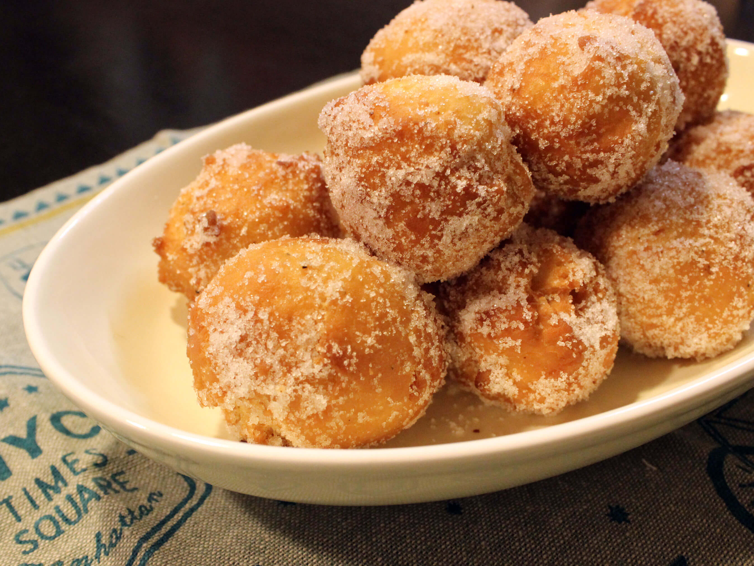
Traditional Food
Kalakukko
Black bread
Fish and meat
Munkki
Donuts
cinnamoroll

Slide 14
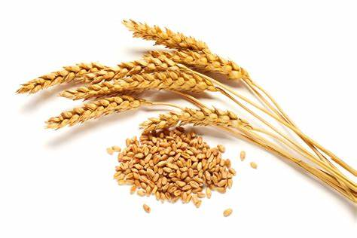
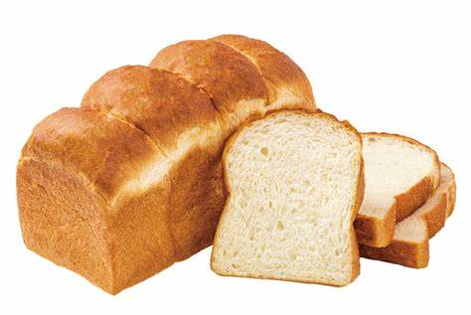
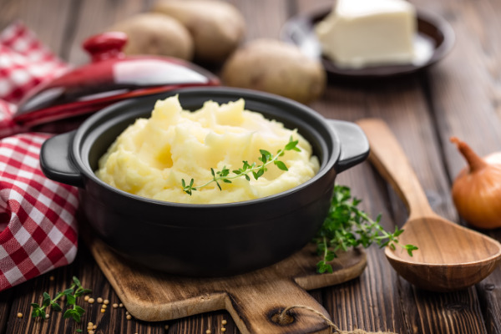
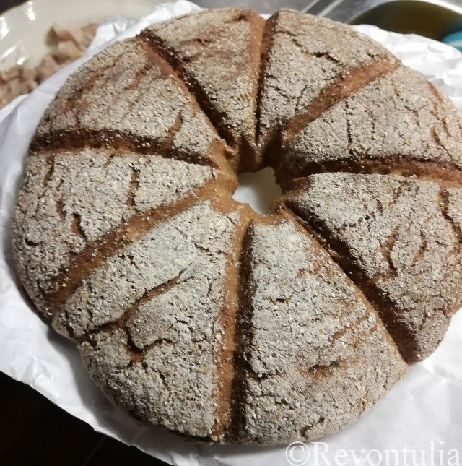
Staple Food
Rye
Bread
Mashed potato
Ruisleipa
Notes:
ここら辺のこととcultural dimension 絡められたらいいのかな？
例えば、ここのdimensionが高いからこういう結果になっているとか。

Slide 15
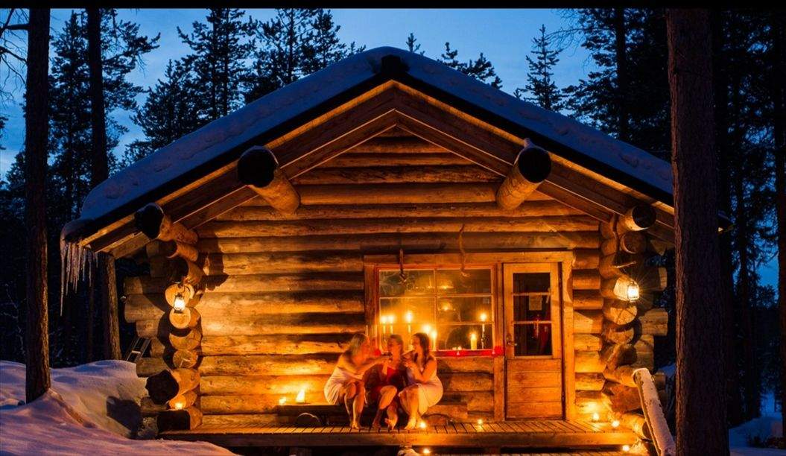
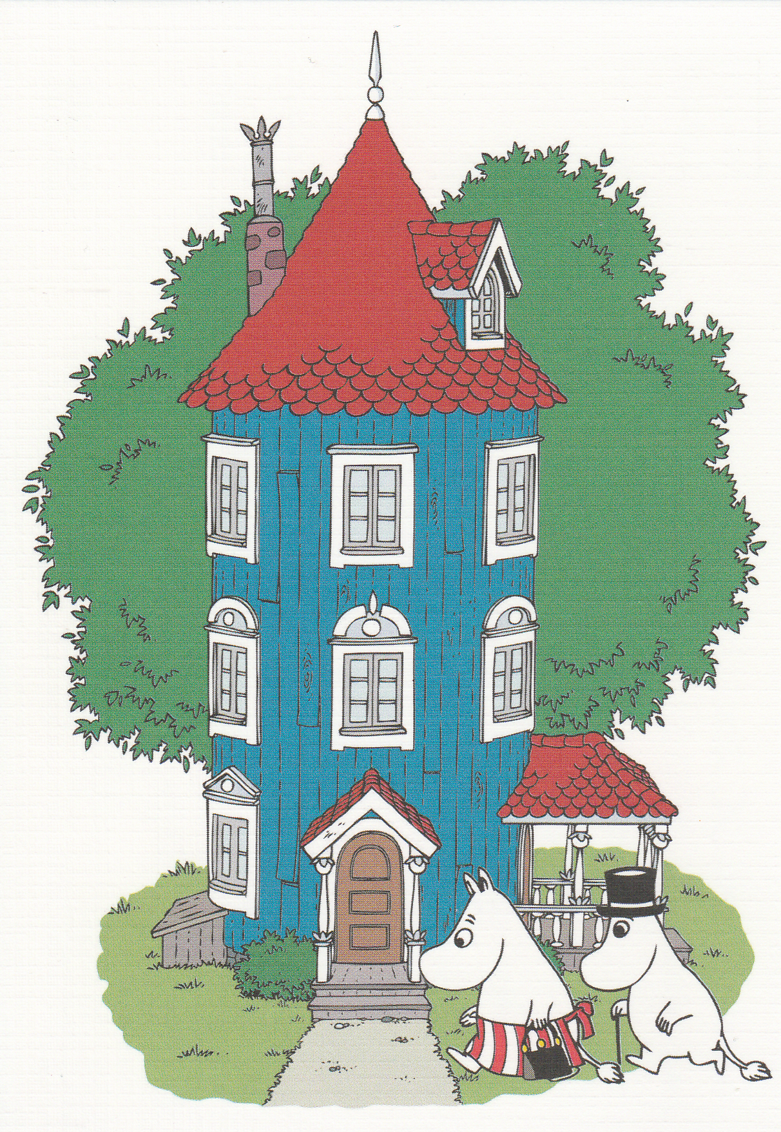
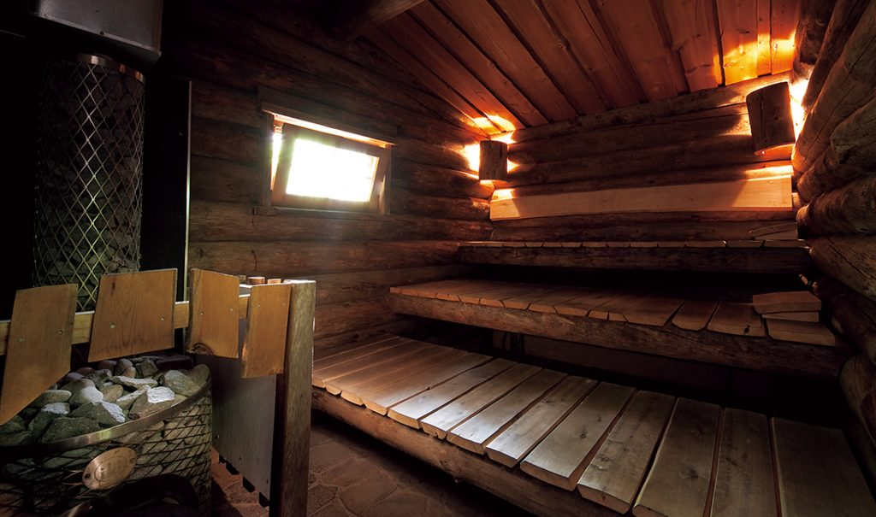
House
Log house
Finland has abundant natural resorces.
Sauna
Inside their house!
Notes:
ここら辺のこととcultural dimension 絡められたらいいのかな？
例えば、ここのdimensionが高いからこういう結果になっているとか。

Slide 16



Social welfare
However
Grocery store: 24%
Restaurant: 14%
Medicine: 10%
Finnish has to pay tax.
Finnish can take the class for free from elementary school to university!!

Slide 17
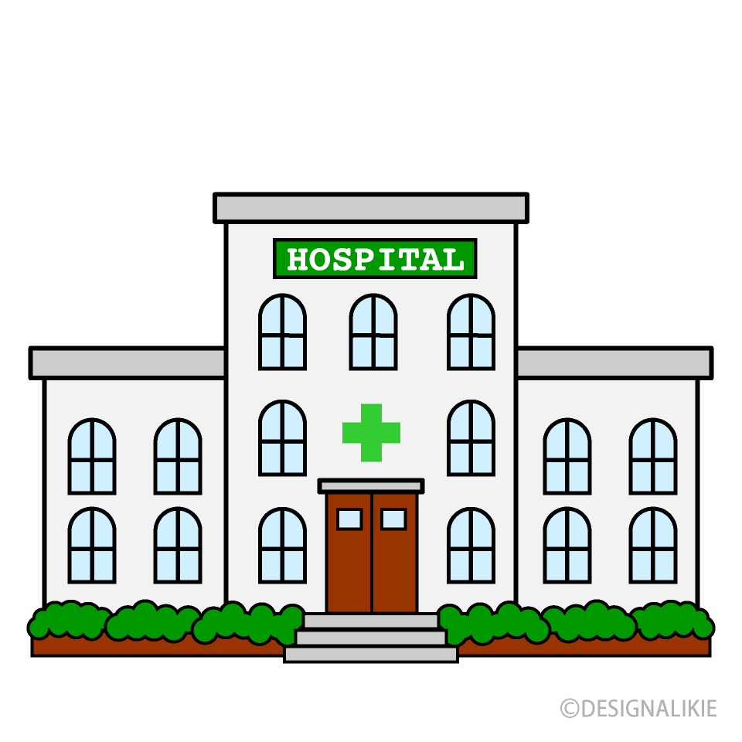
Hospital
 | Cost | time
Public hospital | Low cost | Long time
Private hospital | High cost | Short time

Slide 18
Work
・It is good work environment for both women and men.
→the men can take the childcare leave.
・Women and men are equal at the work place.
・When boss and employee communicate, they say opinion directly.
Low power distance

Slide 19
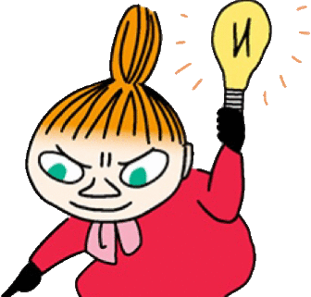
It is time to learn more about Finland!!!

Slide 20
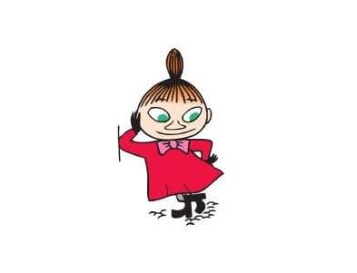
Contents of game
BINGO
Choose the 9 words and write down the paper!
1. Helsinki 11. Sauna 21. individualism
2. Moomin 12. High cost high burden 22. personal space
3. Aurora 13. Childcare leave (holiday) 23. introverted
4. Santa Claus 14. Feminine 24. republic
5. Kalakukko 15. Low power distance 25. independence
6. Munkki 16. White apron 26. parliament
7. Cinnamoroll 17. euro 27. euro zone
8. Mashed poteto 18. Finnish
9. Ruisleipa 19. Swedish
10. Log house 20. high- quality education
Notes:
ここでゲームの目的を紹介。目的：みんなにもっとフィンランドを知ってもらう＆知る（自分たちも含めて）
ここではルール紹介。

Slide 21
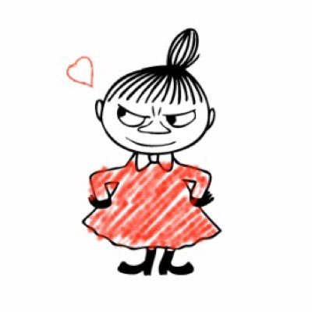
Let’s game!!!

Slide 22
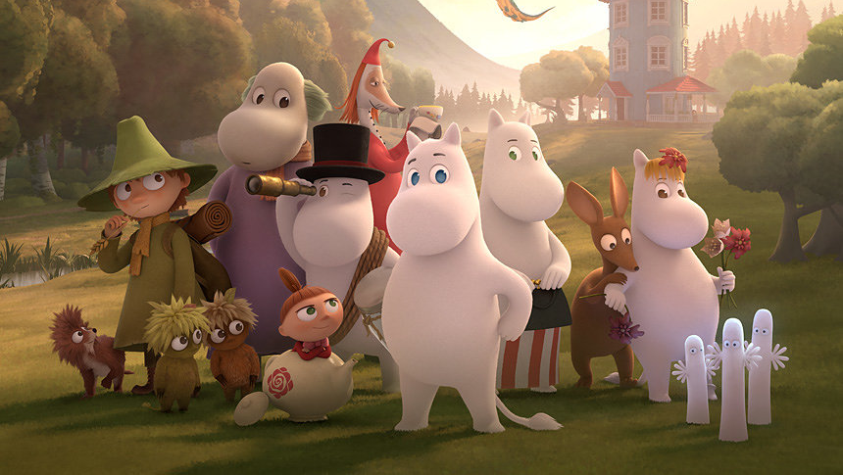
Thank you for listening !

